Slide 1

REAL TIME WEB BASEDAUCTION AND BIDDING SYSTEM
Capstone Project
CSA4305 – Internet Programming
Presented by:
192411091 - POOJASREE B
192471035 - AMRITA ANAIKUMAR
192471048 - VENNA MEENAKSHI REDDY
192471024 - SRIJITHA S
192311363 - MATHUSRI P
Supervised By:
Dr. SUDHAGAR D

Slide 2



ABSTRACT
A web-based platform that enables users to buy and sell products through online auctions.
Provides secure user registration, authentication, and profile management.
Allows sellers to create, update, and manage auction listings. Supports real-time bidding with automatic highest bid tracking.
Integrates secure payment processing and transaction management.
Includes an admin module for monitoring users, auctions, and generating reports.

Slide 3

INTRODUCTION
Online auctions have transformed traditional buying and selling methods.
Enables buyers and sellers to participate from anywhere through the internet.
Eliminates geographical limitations of physical auctions.
Provides transparency through real-time bidding.
Ensures secure transactions and fair winner selection.
Designed for ease of use with an interactive and responsive interface.

Slide 4

PROBLEM STATEMENT
Traditional auctions require physical presence and are time-consuming.
Manual bidding processes are prone to errors and lack transparency.
Difficulty in tracking bids and determining the highest bidder efficiently.
Limited accessibility for buyers and sellers from different locations.
Security concerns in user authentication and payment processing.
Lack of centralized management for auction records and reports.

Slide 5
OBJECTIVES
To develop a secure and user-friendly online auction platform.
To provide secure user registration, login, and profile management.
To enable sellers to add, update, and manage products for auction.
To provide administrators with tools to manage users, auctions, and system activities.
To generate reports for monitoring auction and transaction activities.

Slide 6
LITERATURE REVIEW
Title | Authors & Year | Technologies / Approach | Research Gap
Online Auctioning System (BIDU) | R. Lakshmi Narasimha Reddy et al., 2025 | Web-based auction, real-time bidding | Further improvement needed in security, trust and transaction efficiency. (SSRN)
Online Auction System | Harshal Ekhande et al., 2024 | Web application, real-time bidding | Scope for improving scalability, security and user experience. (IJARIIT)
Online Auction System Using MERN Stack | M. Nageswara Rao et al., 2023 | MERN Stack | Can be extended with stronger transaction management and administration. (IARJ)
Online Auction System Using PHP and MySQL | V. Naveenkumar et al., 2022 | PHP, MySQL | Limited advanced real-time and integrated management features. (Zenodo)

Slide 7
EXISTING SYSTEM & PROPOSED SYSTEM
Existing System
Proposed System
• Traditional auction system and existing online auction platforms are available. • Sellers list products for auction. • Buyers place bids on products. • Highest bidder wins the auction. • Payment is completed after winning. • Some systems are complex and have service charges.
• Simple and user-friendly online auction platform. • Sellers can add and manage products. • Buyers can view products and place bids. • Highest bidder is automatically selected. • Payment and transaction details are stored. • Admin can manage users, auctions, and reports.

Slide 8
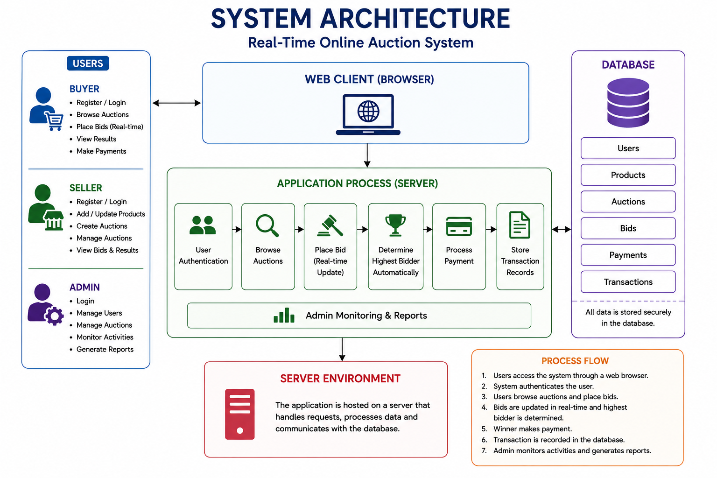
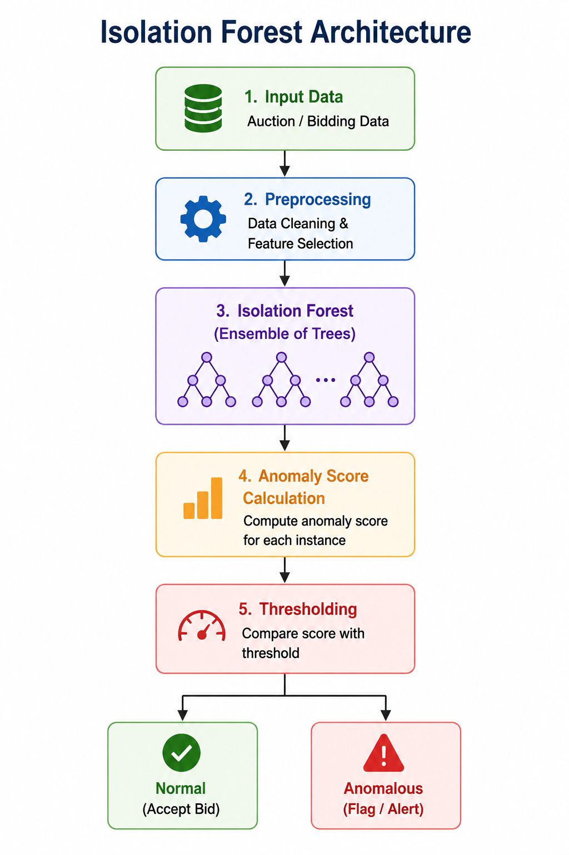
SYSTEM ARCHITECTURE
DATASET USED – UCI Shill Bidding Dataset

Slide 9

MODULE 1
USER MANAGEMENT MODULE
The system allows users to securely register and log in to the auction platform.
The system provides separate access and functionalities for buyers, sellers, and administrators.
Users can update their personal information and account credentials.
The system manages user authentication and authorization.
Administrators can monitor, manage, and control registered user accounts.

Slide 10

MODULE 2 PRODUCT MANAGEMENT MODULE
Sellers can add products to the platform with relevant product details.
Sellers can provide the product name, description, image, starting price, and other required information.
Sellers can update or modify product information whenever required.
Buyers can view and search for products available for auction.
All product information is securely stored and managed in the database.

Slide 11

MODULE 3 AUCTION & BIDDING MODULE
Sellers can create auctions by specifying the starting price and auction duration.
Buyers can browse available auctions and view detailed product information.
Buyers can place bids on products during the active auction period.
The system validates each bid and automatically updates the highest bid.
The system identifies the highest bidder when the auction period ends.
Auction results and complete bidding history are maintained for transparency

Slide 12

MODULE 4 PAYMENT & TRANSACTION MODULE
The system allows the winning bidder to proceed with the payment after the auction ends.
Payment details are recorded and associated with the corresponding auction.
Buyers can view their payment and transaction history.
Sellers can view the transaction details related to their sold products.
Administrators can monitor and manage payment and transaction records.

Slide 13

MODULE 5
ADMIN & REPORTS MODULE
The administrator can manage and monitor registered users on the platform.
The administrator can monitor products and active or completed auctions.
The administrator can monitor bidding activities and auction results.
The administrator can manage payment and transaction records.
The system generates reports related to users, products, auctions, and transactions.
The administrator can monitor overall system activities to ensure efficient operation.

Slide 14
SOFTWARE REQUIREMENTS
Operating System: Windows, Linux, or macOS
Frontend: React.js, HTML, CSS, JavaScript
Backend: Spring Boot (Java) or Node.js
Database: MySQL
AI Framework: Python, TensorFlow or Scikit-learn
IDE: VS Code, IntelliJ IDEA, or Eclipse
Browser: Google Chrome, Microsoft Edge, or Firefox

Slide 15
CONCLUSION
The Real-Time Web Based Auction and Bidding System provides a secure and user-friendly platform for conducting online auctions.
The system automatically tracks the highest bid and selects the winner when the auction ends.
Payment and transaction details are maintained for accurate record keeping.
The admin can manage users, auctions, transactions, and generate reports.
The proposed system improves transparency, accessibility, efficiency, and reliability in the online auction process.

Slide 16
THANK YOU!!

